Slide 1
Inside Science
Resources
Sarah Jeong, MLIS
Research & Instruction Librarian for Science
October 4, 2018

Slide 2
“Literature search is an integral part for modern interdisciplinary research.”
“Literature search is an integral part for modern interdisciplinary research.”
“Literature search is an integral part of modern
Interdisciplinary research.”
-WFU Ph.D. student
-Chemistry Ph.D. Student

Slide 3
Today
Literature Searching Web of Science & Inspec SciFinder
IEEE Xplore
Research Metrics Scopus & Essential Science Indicators
Reference Managers Zotero/Mendeley/Endnote
Interlibrary Loan/Book Orders
Book a Research Session

Slide 4
Science Citation Index (1945- )
Social Science Citation Index (1956- )
Arts & Humanities Citation Index (1975- )
Inspec (1969- )
MEDLINE (1950- )
Biological Abstracts (1980- )
Emerging Sources Citation Index (2015- )
SciELO Citation Index
Russian Science Citation Index
KCI - Korean Journal Database

Slide 5
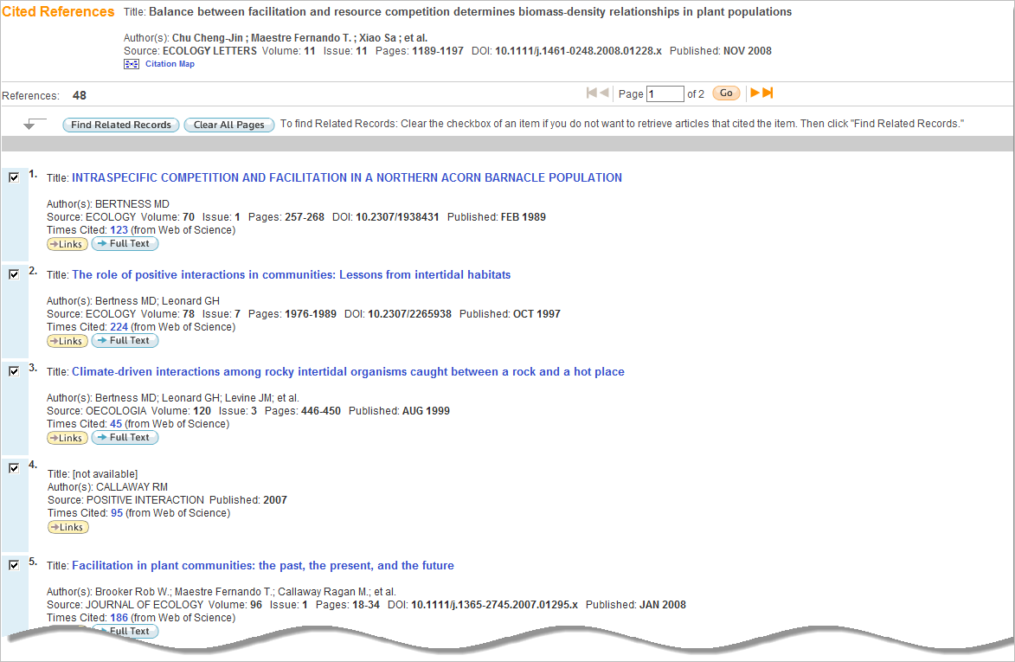
Cited References in blue are linked to full records (limited by your subscribed data years).
Cited References in plain text are citations to items outside of your coverage, items not indexed in Web of Science (books, etc.), or items that have been cited incorrectly by the author (cited reference variants).
Notes:
When you click on the Cited References number, you will get a list of items that might look something like this.
**The title of the first reference here is blue, and it will link you directly to the source record in WoS.
** The fourth record is plain text, and it could be displayed this way for a number of reasons. Either the item is outside of your coverage, it does not have a source record in WoS (book, etc.) or it could be a citation variant. If an author incorrectly cites a reference, there is a problem linking that information to a source record with conflicting citation information.
**You’ll notice that you are still able to navigate to the list of citing articles, even for citation variants.
You can use WoS to answer questions like:
What papers on this topic are the most highly cited?
Which authors have published the most papers on this topic?
What organizations fund research in this area?
What institutions are involved in research related to this topic?

Slide 6
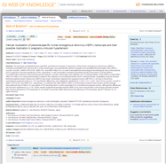
2004
2008
Times Cited
2003
2009
2000
Cited References
2000
Related Records
1974
1998
2008
1993
…navigating
Backward in time via Cited References
Forward in time via Times Cited
and through Related Records
1999
2002
2000
Notes:
Locate a single paper using traditional search techniques, this is the paper in the center of the screen. Click the “Cited References” link to see all the research that this discovery was based upon. Click the “Times Cited” link to see the more recent developments. Click “Related Records” to see research that is closely related to the original article. A Related Records search uses the concept of co-citation to establish the relationship; based on the fact that similar items often cite the same thing.

Slide 7
Proximity Operators
By default, there is an implied AND connecting terms entered as a phrase. Searching a phrase retrieves records that contain all searched terms found in the titles, abstract or key words fields. color theory = color AND theory
Phrase Searching | Exact matches for phrases can be found by searching on terms enclosed in quotation marks. Wildcard characters can be used inside quotation marks. “color theory” = color theory “color* theory” = color theory colorful theory
Near/ | Finds terms in the same field; user specifies proximity. Default is 15 words if user does not specify a number. color near/5 theory = color theory theory of color color plays a role in this theory theory. In this way, color…
Same | Terms must occur within the same sentence. Use in Address field only.
Notes:
7
Proximity is a way to specify how close one term should appear to another.
If you would like to search for an exact phrase, enter it in quotation marks. You may truncate a phrase that is within quotes to retrieve variations in spelling and plural forms. Note that the use of quotation marks disables the automatic search assistance or lemmatization.
NEAR finds terms within the same field, and allows you to specify how far apart terms should be. If NEAR/10 is used, search terms must be within a maximum of 10 words from one another. If no number is specified the default is 15 words.
The SAME operator is used only in the Address field and retrieves terms that all occur within the same address.

Slide 8
Wildcard Characters (Truncation)
Symbol | Retrieves | Example
* | Zero or more characters | hydroxy* = hydroxylase *hydroxy = dihydroxy *hydroxy* = polyhydroxyphenyl
? | One character only | en?oblast = entoblast endoblast
$ | Zero or one character | eight$ = eight eighth eighty
Topic searches must have at least 3 characters to use *.
Notes:
8
Here is a list of wildcard characters that are supported in Web of Knowledge.
The asterisk is the most flexible symbol and stands for any number of characters, including zero.
For topic searches you must have at least three characters if you use the asterisk wildcard character. That’s just for the topic search field.
The question mark stands for one character only.
The dollar sign stands for zero or one character. You cannot use the dollar sign for terms enclosed in quotation marks.
Automatic search assistance returns results with the plural forms of nouns, comparative forms of adjectives and different verb tenses. Also searches for British/U.S. English spelling variations. This is a purely linguistic feature, so it doesn’t work on a conceptual level. Tooth→teeth, run/running/ran, good/better/best

Slide 9
SciFinder

Slide 10
Chemical Abstracts → SciFinder
Late 1950s
Added registry numbers
2004
SciFinder Scholar purchased by ZSR Library
1907
CA compiled citations & abstracts for major chemical journals
Late 1990s
SciFinder Scholar available via desktop client software
2012-present
Unlimited users on SciFinder at WFU

Slide 11
Begun 1907- but now goes back to 1800s including U.S. chemical patents 1808-1859
Identification for each chemical in CAplus database. Experimental & Predicted properties
Database of chemical catalogs supplied by vendors by price & availability

Slide 12
Reaction database, searchable by structure going back to 1840s
Regulation of chemical substances, both U.S. and abroad
Biomedical citation database of PubMed produced by the National Library of Medicine

Slide 13
Registry Record
Allows you to print Experimental Properties, extracted from actual papers, instead of entire record.
Predicted Properties determined by software algorithms.

Slide 14
Journal Citation 156:676941
Can reference it CAN:156:676941
Document Identifier Always year:number or volume:number

Slide 15
Notes:
https://www.fiz-karlsruhe.de/en/leistungen/kristallographie/icsd.html

Slide 16
“While working in a specific sub-discipline of science, I strongly feel we need to cross the boundary of one sub-discipline and should be able to appreciate and correlate to other divisions of science and engineering.”
-Chemistry Ph.D. student
“While working in a specific sub-discipline of science, I strongly feel we need to cross the boundary of one sub-discipline and should be able to appreciate and correlate to other divisions of science and engineering.”
-WFU Ph.D. student

Slide 17
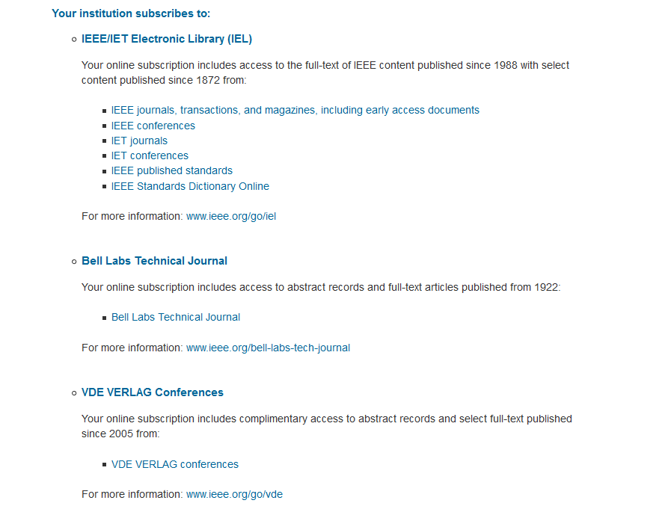
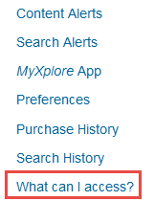
IEEE Xplore Digital Library Unlimited full text access includes…

Slide 18
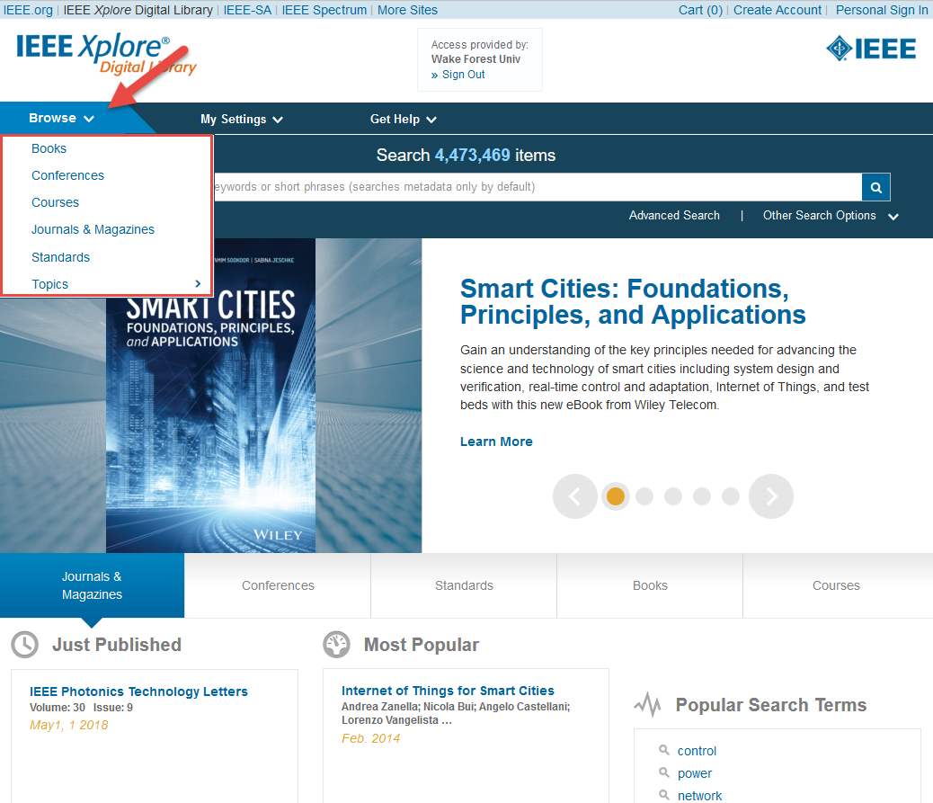
IEEE Xplore has a variety of BROWSE options

Slide 19
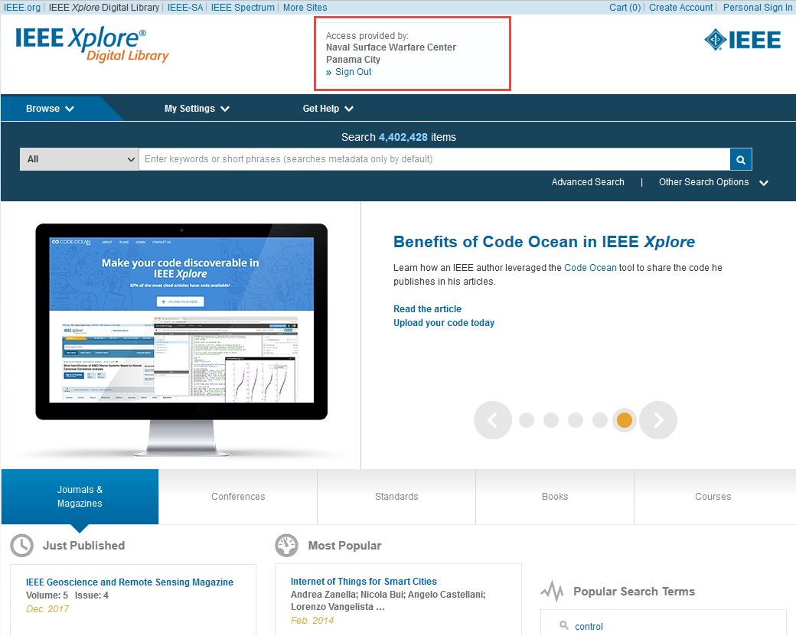
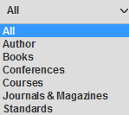
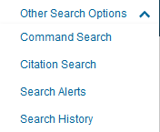
IEEE Xplore has a variety of SEARCH options

Slide 20
IEEE Xplore has a variety of search options
Search bar on the home page – searches metadata only (Citation, abstract, index terms). Automatic AND unless you use “”.
ADVANCED SEARCH – searches metadata or full text. Boolean operators of AND, OR, NOT. 25 fields for filtering with a maximum of 11 keyword.
COMMAND SEARCH - searches metadata or full text. Boolean operators of AND, OR, NOT, NEAR, ONEAR. A maximum of 15 terms

Slide 21
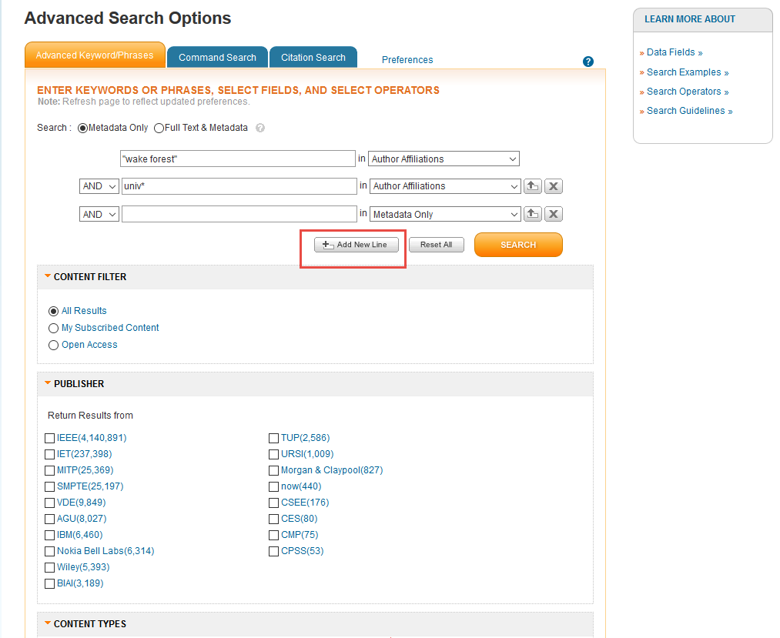
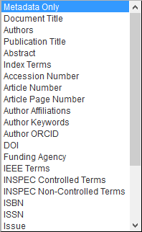
Advanced Search allows for more precision

Slide 22
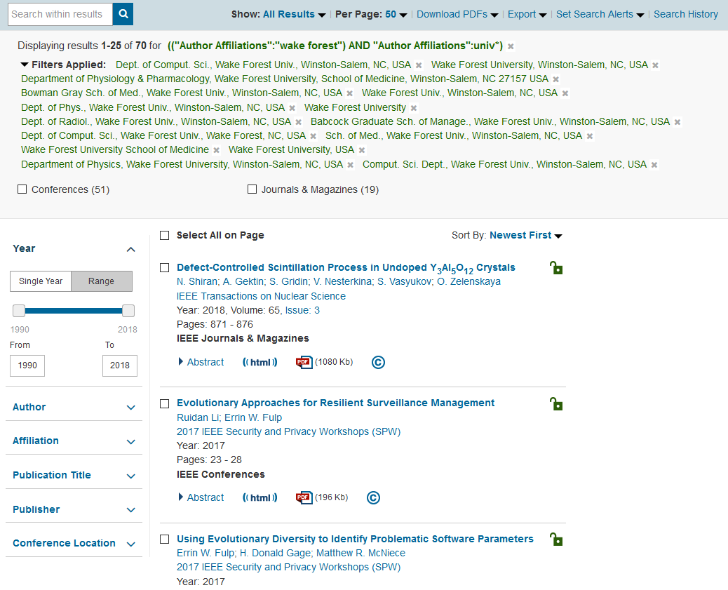
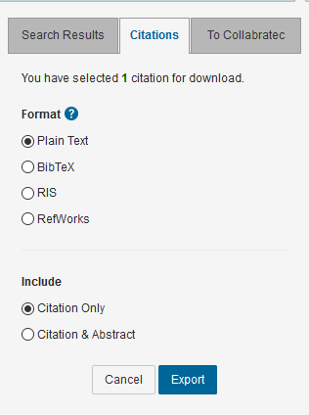
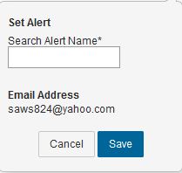
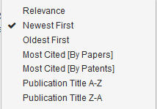
Refine, export, set search alert

Slide 23
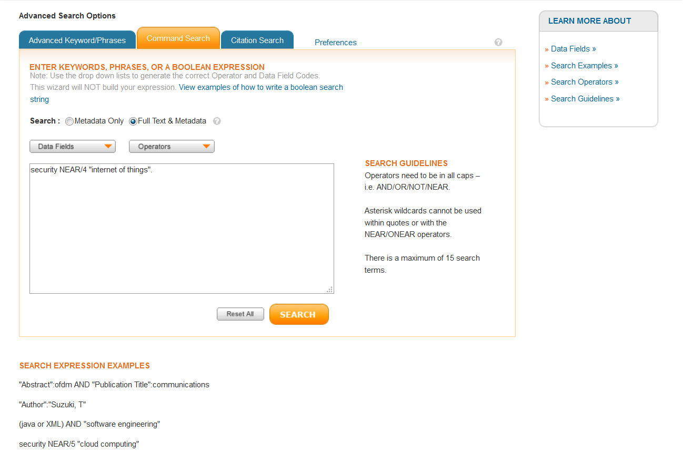
Command Search
Metadata only
security AND “internet of things” 1988
security NEAR/4 “internet of things” 234
Full text and metadata
security AND “internet of things” 10,164
security NEAR/4 “internet of things” 1,241
15 keywords
The only search to allow the NEAR or ONEAR operator

Slide 24
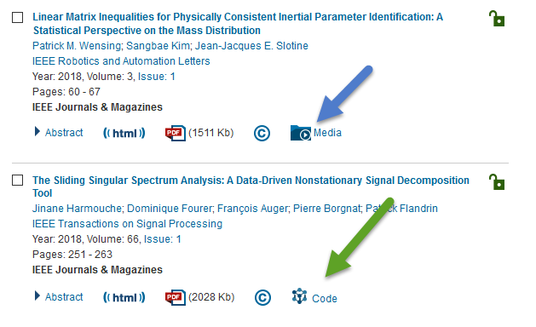
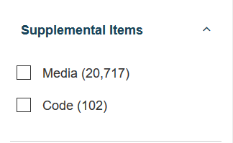
Supplemental items – PPT, video, author code

Slide 25
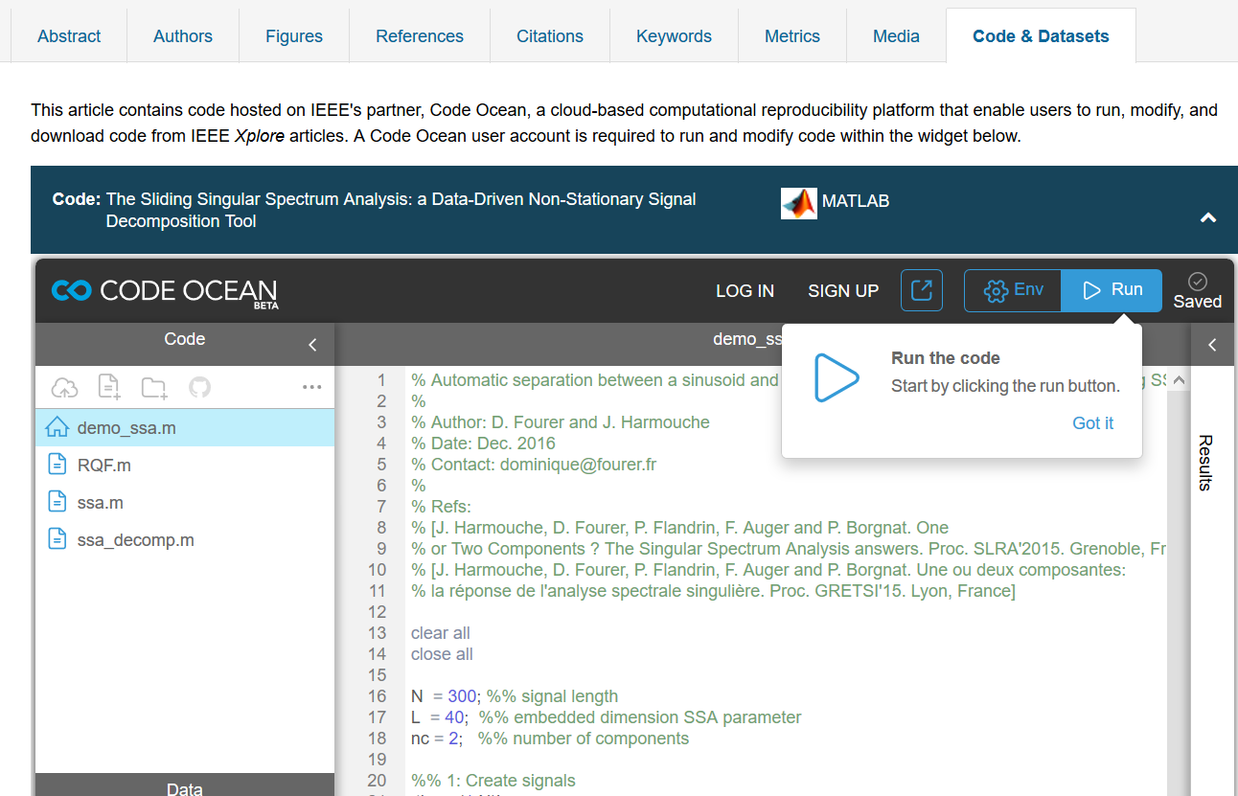
New Code & Datasets Tab within Article
Link to code on Code Ocean, where users may view, run, modify, and download code.
25

Slide 26
Today
Literature Searching Web of Science SciFinder
IEEE Xplore
Research Metrics Scopus & Essential Science Indicators
Reference Managers Zotero/Mendeley/Endnote
Interlibrary Loan/Book Orders
Book a Research Sesion

Slide 27
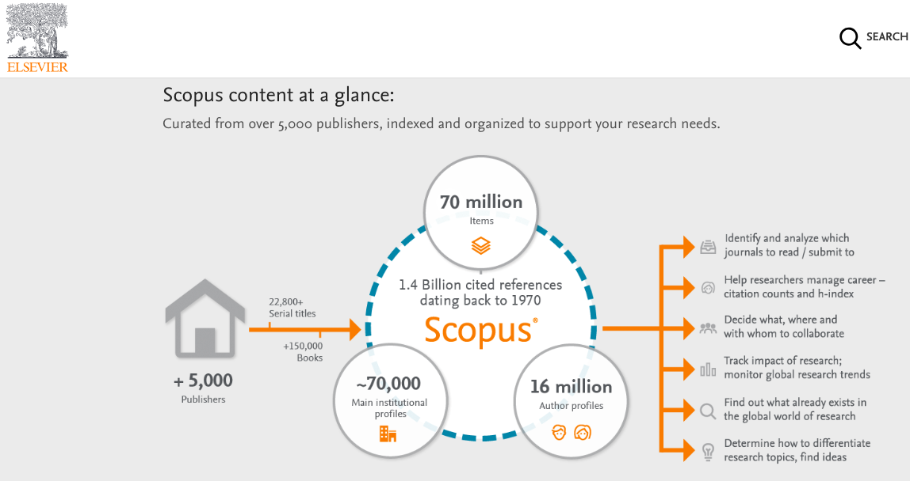
https://guides.zsr.wfu.edu/metrics
Notes:
https://clarivate.com/products/essential-science-indicators/
https://www.elsevier.com/solutions/scopus/how-scopus-works/content

Slide 28
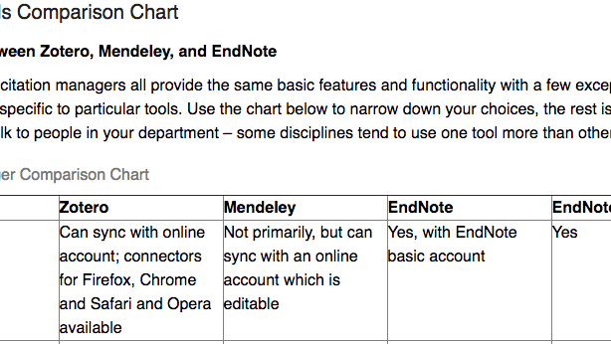
Notes:
http://guides.libraries.psu.edu/CitationStyles/Tools
https://integrity.mit.edu/handbook/what-plagiarism

Slide 29
Interlibrary Loan
Books
Articles
Off-site storage
http://zsr.wfu.edu/ill

Slide 30
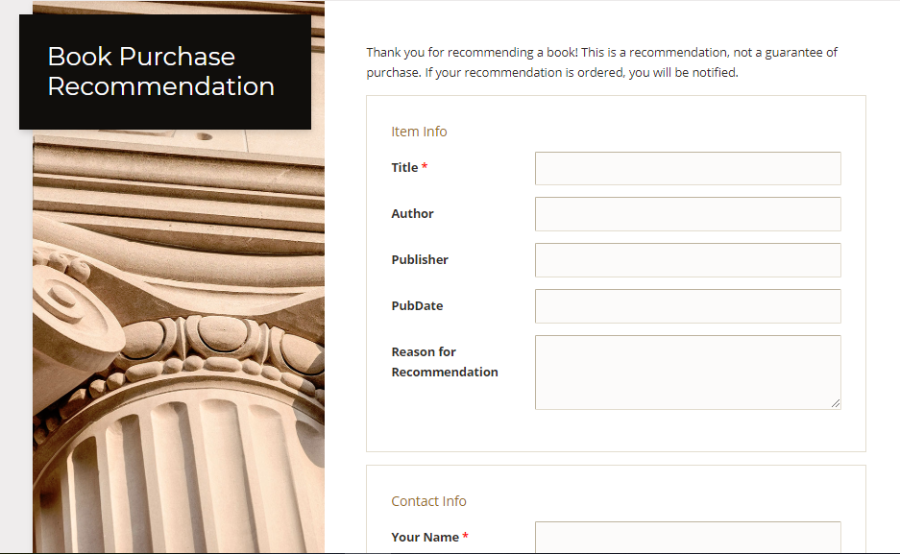

Slide 31
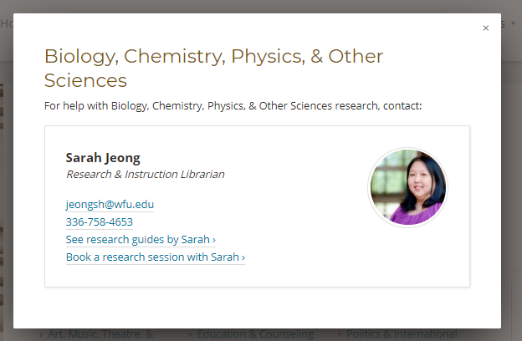
Questions? guides.zsr.wfu.edu/sarah

